Slide 1
TVAA KA Re-flash Method
For R-Theme Coaching application development environment
2018/02/02

Slide 2
TVAA DA Re-flash Method
Software re-flash for TVAA DA needs the below 5 step sequence.
USB drive Setup
Software Update
Parameter Update
Data Reset (All Data Clear)
Version Check
No need.
→After the data reset, Anti-theft screen will be displayed.
VIN information is required to unlock Anti-theft.
Please turn ENG or IG on to unlock Anti-theft.
※Caution
During STEP2 through STEP3, some error message will be displayed such as “Unfortunately HOME app has stopped”.
However these errors are caused by mismatch between software and parameter.
Please ignore these error messages during the re-flash process.

Slide 3

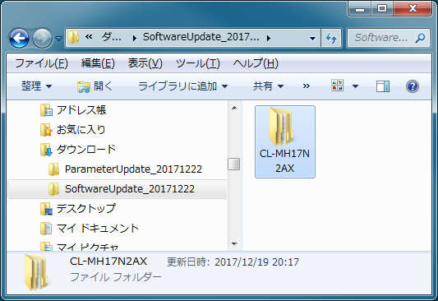
■STEP1：USB drive Setup
■用意するもの
4GBかそれ以上のUSBメモリ
Windows7以上のPC
アップデート用のファイル(folder name is “SoftwareUpdate_20180202”)
USBメモリをPCに挿してください.
CL - MH17N2AX フォルダの中の“SoftwareUpdate_20180202”をUSBメモリにコピーしてください.
コピーが終わったらUSMメモリを抜いてください.
USB directory tree
USB drive root
└── CL-MH17N2AX
└── force_loading.zip

Slide 4
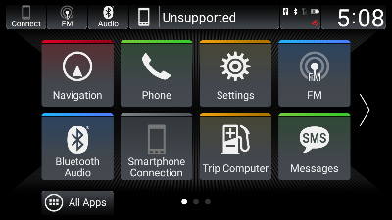
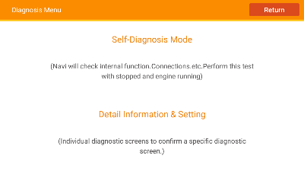
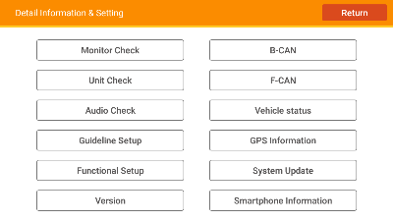
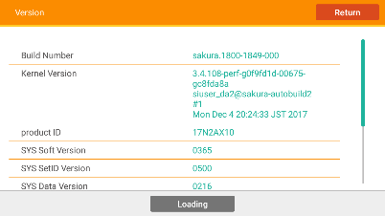
■STEP2：Software Update
(1) D/AのUSBポートにUSBメモリを挿してください
HW Key Operation
Touch screen Operation
No need to operate
(2) ホーム画面を開いてDealer Diagnosisの中のVersion screenを開いてください.
5秒間押し続けてください
[HOME]+[POWER]+[SOURCE]
“Detail Information & Setting”
をタップ
Home Screen
Diagnosis Menu
“Version”
をタップ
Detail Information & Setting
Version Screen
(値はサンプルです.)

Slide 5
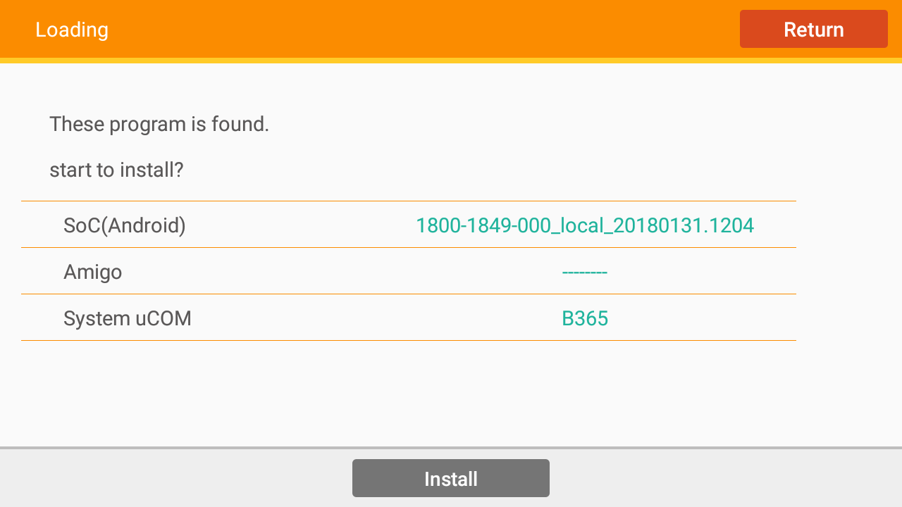
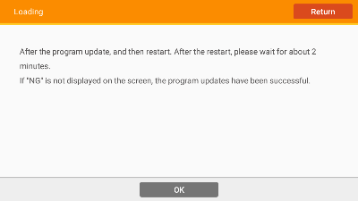
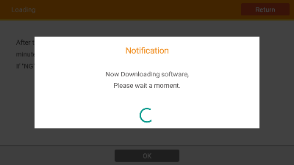
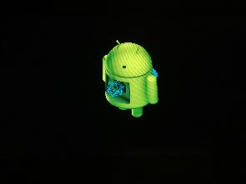
■STEP2：Software Update
(3) アップデートを開始してください(約10分かかります.)
Before start installing,
please check the SW version with expected or not.
SoC(Android) : 1800-1849-000_local_20180131.1204
Amigo : --------
System μCOM : B365
“Loading”
をタップ
Version Screen
Loading Screen
“Install”
をタップ
(値はサンプルです.)
(These values are example)
“OK”
をタップ
しばし待たれよ
VUP Confirmation screen
Downloading
Updating
※Warning
アップデートが走っている最中は絶対に電源を落とさないでください.

Slide 6

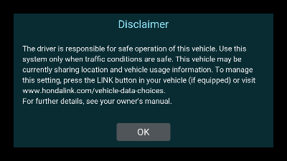
■STEP2：Software Update
(4) アップデート完了後、自動で再起動します.
再起動
Updating
Start up logo
“OK”
をタップ
-> 次のページへ
※Caution
Disclaimer
Home Screen
After starting up, some error message will be displayed such as “Unfortunately HOME app has stopped”.
However these errors are caused by mismatch between software and parameter.
Please ignore these error messages during the re-flash process.

Slide 7

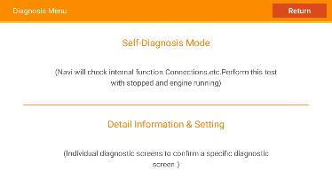
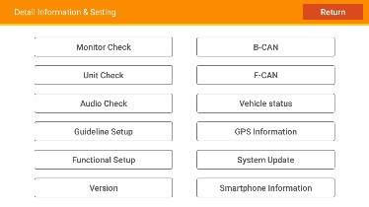
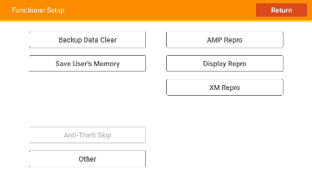
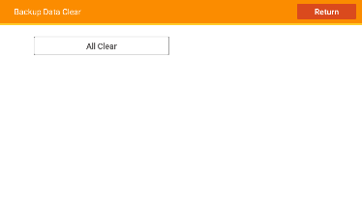
■STEP4：Data Reset(All Data Clear)
(1) 再起動後, Dealer Diagnosisの中のBackup Data Clear画面を表示してください.
5秒間押し続けてください
[HOME]+[POWER]+[SOURCE]
“Detail Information & Setting”
をタップ
Home Screen
Diagnosis Menu
“Functional Setup”
をタップ
“Backup Data Clear”
をタップ
Detail Information & Setting
Functional Setup
Backup Data Clear

Slide 8
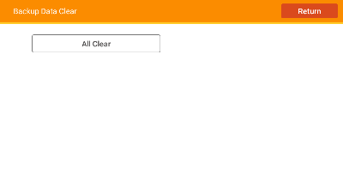
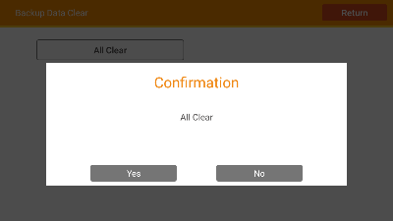
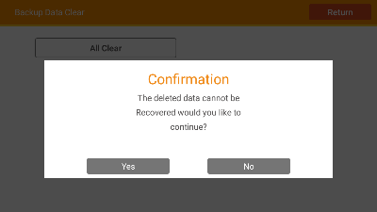
■STEP4：Data Reset(All Data Clear)
(2) “All Data Clear”を実行してください
“All Clear”
をタップ
“Yes”
をタップ
Backup Data Clear
All Data Clear Confirmation popup
Sometimes, it takes more than 10 sec till start reset
after pressing “Yes”.
Even that happen, please wait for a while without any operations.
“Yes”
をタップ
Reset
All Data Clear Re-Confirmation popup
※Warning
Data Resetの間は絶対に電源を落とさないでください.

Slide 9
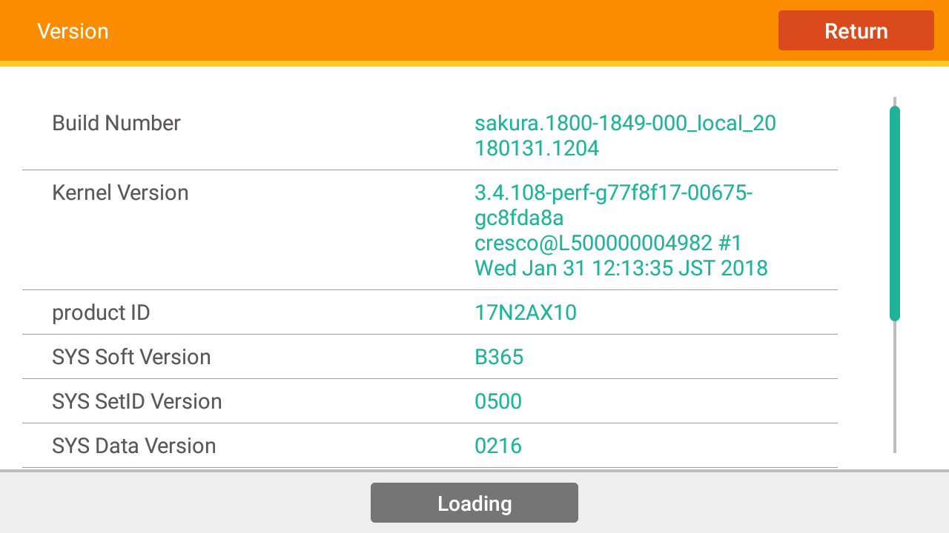
■STEP5：Version Check
再起動後、 Dealer Diagnosisの中のVersion screenを開いてください.
5秒間押し続けてください.
[HOME]+[POWER]+[SOURCE]
“Detail Information & Setting”
をタップ
Home Screen
Diagnosis Menu
“Version”
をタップ
Detail Information & Setting
Version Screen
Please check the final version is correct with expected.
(See next page.)

Slide 10
■STEP5：Version Check
①
②
③
Version Screen
① |  | Build Number | SoC Software version | sakura.1800-1849-000_local_20180131.1204
② |  | product ID | Vehicle Parameter type & version | 17N2AX10
③ | ③-1 | SYS Soft Version | SYS Software version | B365
 | ③-2 | SYS SetID Version |  | 0500
 | ③-3 | SYS Data Version | SYS Parameter type & version | 0216

Slide 11
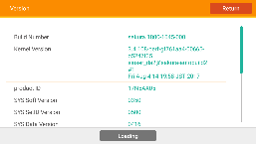
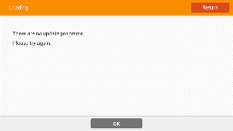

■FAQ
# | Q | A
1 | “There are no update programs. Please try again.” message is displayed. And doesn’t start version up on STEP2 with the below screen after pressing “Loading” button. | Version up file name or folder name in STEP2 USB is not match with DA. →Need to use other version up data. Please tell to Panasonic with “Product ID” in Version Screen and folder/file name in USB.
2 | “There are no update programs. Please try again.” message is displayed. And doesn’t start version up on STEP2 or STEP3 with the below screen after pressing “Install” button. | Version up file in STEP2 or STEP3 USB is not match with DA. →Need to use other version up data. Please tell to Panasonic with “Product ID”

